Slide 1
Exploring Middleware for LLM Tech Stack: Action Items for Developers & Investors.

Slide 2

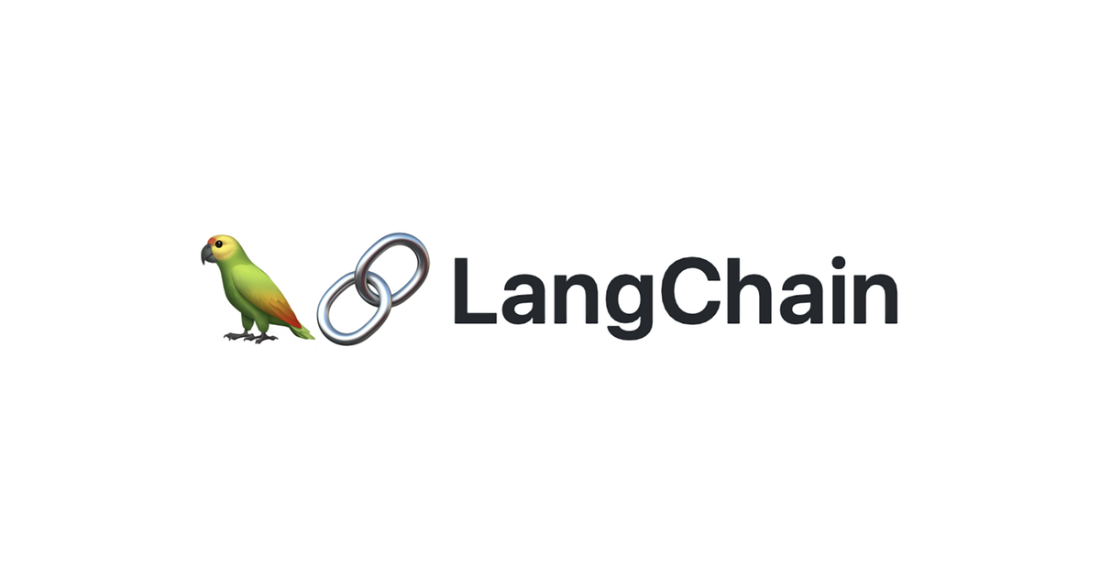
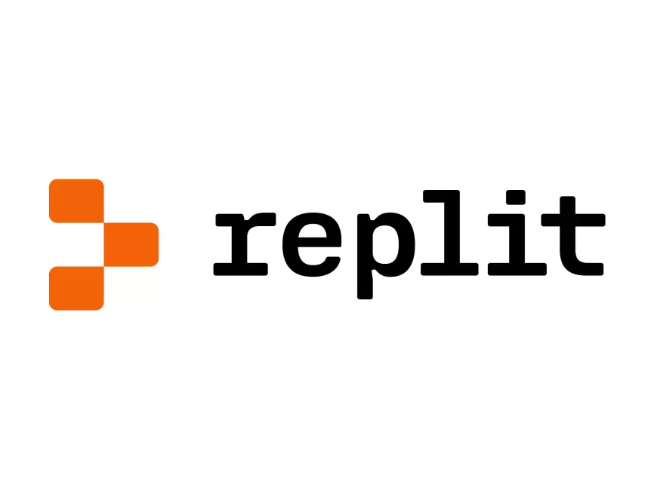
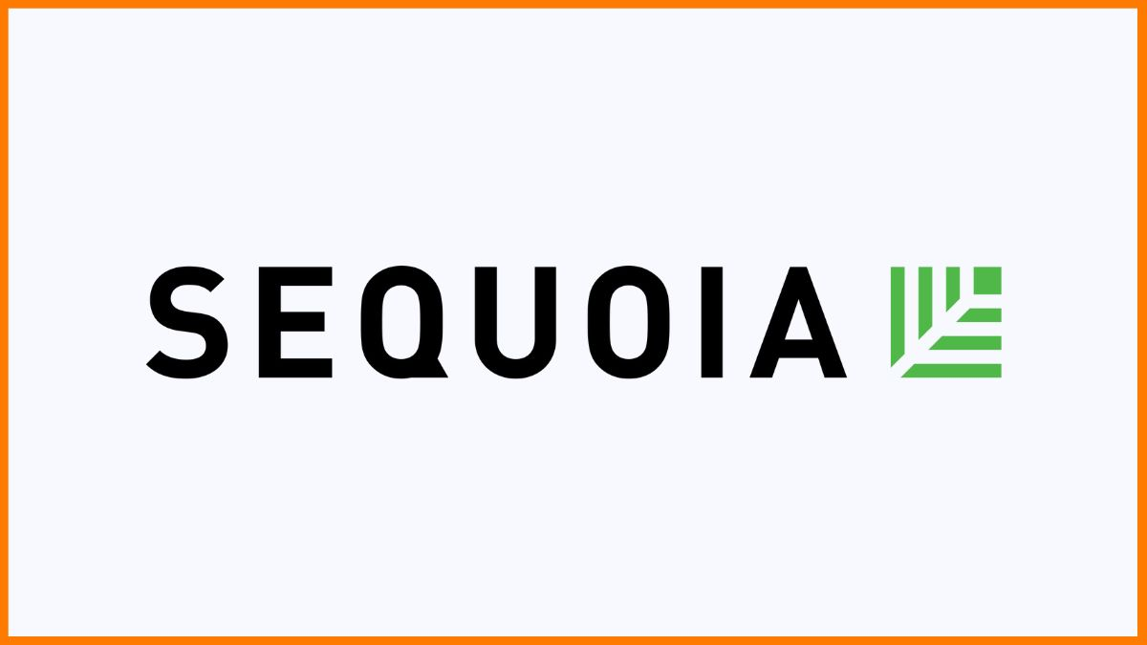
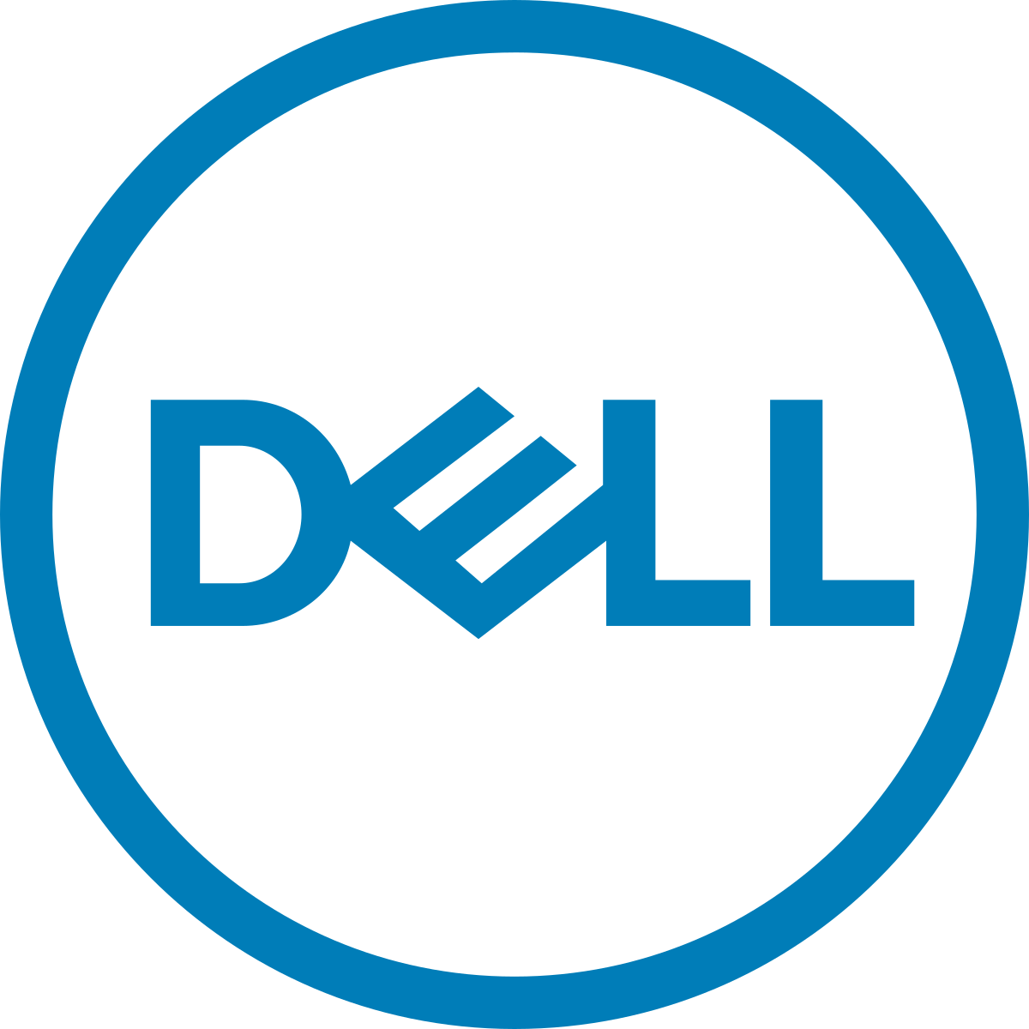
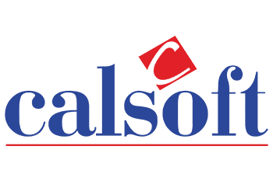

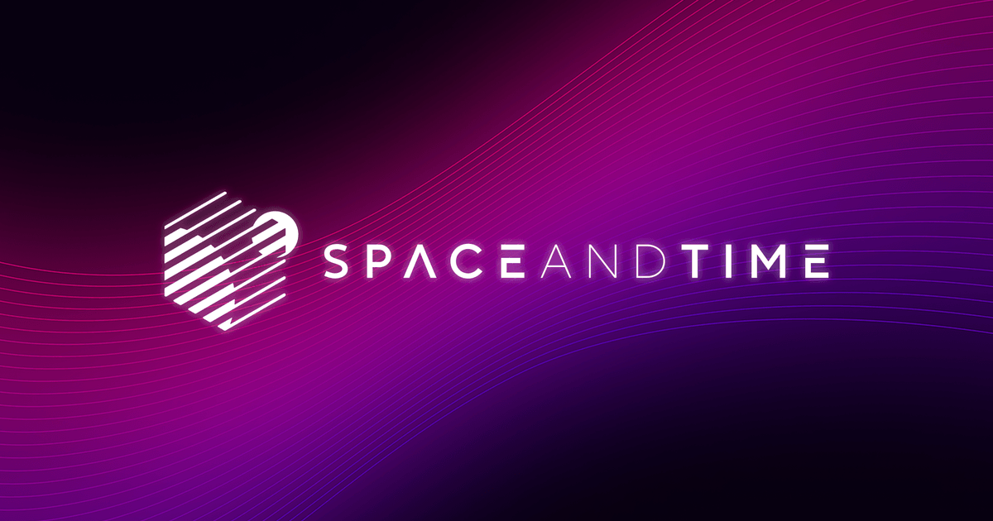

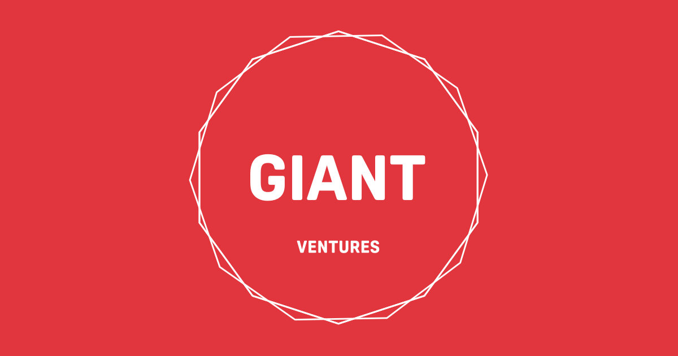

About me:
Pushed GPT-3 to summarize startup pitches for a VC fund in 2022, before ChatGPT came out.
Worked across SRE, Venture Capital and engineering.
Current: Independent software and GenAI consultant.
Some teams I have worked with:

Slide 3
From "Software is eating the world" to "AI is eating the software that is
eating the world”
Shift towards Gen-AI
The global economy has undergone a significant transition from being fuelled by industrialization to being driven by knowledge and information. Technological advances and platform shifts, such as the Internet, cloud computing, and smartphone ubiquity, have revolutionized the way people communicate, create, and consume content. The next platform shift is on the horizon, which will be defined by artificial intelligence (AI).
Recent advancements in LLMs and other ML tools have streamlined content creation. LLMs, complex neural networks that can generate text, are growing in size and sophistication at a rate of 10x per year. Modern AI can now autonomously create text, visual, audio, code, data, and multimedia comparable to human benchmarks. Language models are becoming the cognitive structure of real-world AI, and advancements are accumulating, leading to an inflection point where AI will redefine the knowledge and information economy.
Drivers for Acceleration Benchmarking Modalities, %age Market Penetration, %age
Human Baseline | Generative AI is becoming more powerful and robust, with many models surpassing human benchmarks.
Flywheel Effect | Advancements in LLMs are benefiting downstream and multi-modal models, mimicking how humans use different modalities to comprehend information.
Accessibility | Access to private APIs and open source models for generative ML is now available to developers, with an acceleration in activity following recent sponsorship of open source models.
12
Gen Content Smart Phone (US) CaaS
66
20
-2
4
-10
-24
55
Image Gen
-8
Text Gen Speech Gen
2021 2022
10
-16
15
35
6
22
-4
7
8
²⁰²³ Year 3 Year 6 Year 9
Using LLMs and other generative AI tools in your software and applications can streamline content creation, improve user engagement, and enhance overall user experience. These tools automate content generation, reduce manual effort, and increase productivity. LLMs can produce high-quality content comparable to human benchmarks, resulting in more engaging content.
SOURCE REFERENCED: Bessemer Venture Partners: Is AI generation the next platform shift?

Slide 4
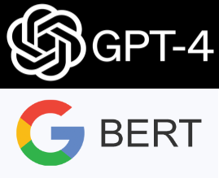





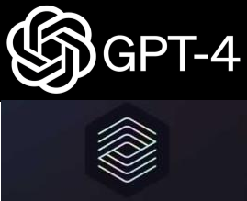

Progressing towards fully automated LLMs, Currently functioning as co−pilot assistants in their respective categories of service.
Categories Models ^{Large Model Availability}
First Attempts
Almost There
Prime Time
Text Generation |  | Spam Detection Translation Basic Q&A | Basic Copy Writing First Drafts | Longer Form Second Drafts | Vertical Fine Tuning gets good | Final Drafts better than human. | Text to Product (Final) AI Developer
Image Generation |  |  |  | Art Logos Photography | Mockups (Product Design, Architecture) | Final Draft (Product Design, Architecture) | Final Drafts better than Professionals
Video Generation | X-Clip |  |  | First Attempts at 3D/Video Models | Basic/First Draft Videos and 3D Files | Second Drafts | Movies are personalized
Code Generation |  | 1-Line Autocomplete | Spam Detection Translation Basic Q&A | Longer Form Better Accuracy | More Language More Verticals | Text to Product (Draft) | Text to Product (Final) AI Developer
Pre-2020 2020 2022 2023 2025 2030
With the advent of LLMs, availability for each category of service has evolved, and we are now "almost there" in reaching the peak of "prime time." Currently, LLMs are considered to be co-pilot assistants to various categories of service. However, customers are looking for further capabilities to automate the entire process, akin to an auto-pilot. They expect to have a desired final draft output close to an amateur.
SOURCE REFERENCED: Sequoia Capital: Generative AI: A Creative New World.

Slide 5
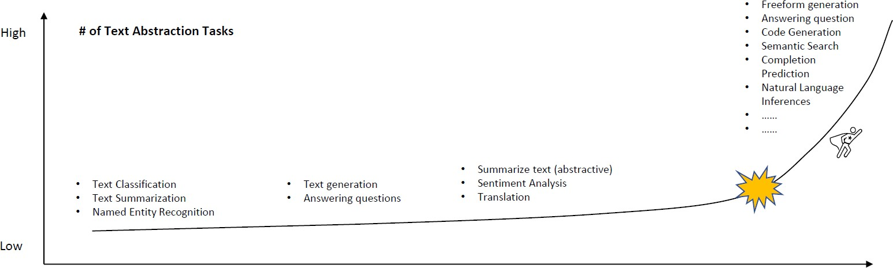






The development of GPT−2 RLHF has marked an inflexion point for NLP, an Opportune time for the advancement of Generative AI.
Progression of LLMs performing Text Abstraction Tasks with Parameter Count
GPT-3 demonstrated impressive language generation abilities, but when GPT-2 was combined with ChatGPT, it leveraged reinforcement learning with human feedback to improve its language modelling capabilities. This integration led to the emergence of advanced text abstraction techniques, including inflexion analysis. With the introduction of GPT-4, which has been recently released, it now includes multimodal capabilities that allow it to handle multiple modes of input.
Elmo (2018)
BERT (2018)
GPT-2 (2019)
Megatron (2019)
T5 (2019)
Turing-NLG (2020) GPT-3 (2021) GPT-2 RLHF (2022) GPT-4 (2023)
100 Mn | 300 Mn | 1.5 Bn | 8.3 Bn | 11 Bn | 17.2 Bn | 175 Bn | 175 Bn | 100 Tn

Slide 6
Developers Focusing on Continuous Improvement: A Shift Towards High-Performing Teams and Improved Business Outcomes.
Understanding Developer’s
The inclination towards creation drives developers to excel in their field, and their proficiency in software/application development has led to the establishment of developer-led businesses worldwide, yielding multi-billion dollar outcomes not restricted to the technological sphere.
In the current landscape of software/application development, the traditional approach of compartmentalizing engineering teams into distinct roles such as developers, testers, and system administrators, and providing infrequent product updates every three months has become outdated. Instead, high- performing software teams today strive for a philosophy of continuous improvement.
This shift in approach, as highlighted in Google's 2021 report, has resulted in a significant increase in code deployments - a staggering 973 times more frequent - and a 3x lower rate of failure when implementing changes. Furthermore, teams that adopt this philosophy are able to recover from incidents at a rate 6570 times faster than teams that do not prioritize continuous improvement.
DevTool’s Offering DevTool’s Positioning
Value Proposition | Increases Efficiency | Improves Experience
Target Customers | Engineers | Tech Companies
GTM Strategy | Bottoms-Up | Open Source Software
Product Focus | Integrations or Alternative solutions
Bottoms-Up
Pre-PMF
Consumer
Software
Enterprise Software
Complete
Shift
The shift from consumer to enterprise software development post-pmf has led to the increased use of DevTools. It has made it easier to develop, test, and deploy these applications, resulting in greater flexibility, scalability, and cost-effectiveness for businesses. This shift has transformed the software development industry and allowed businesses to adopt new technologies and stay competitive.
SOURCE REFERENCED: Bessemer VP: Developer platforms in India by Anant Vidur Puri, Aparna Chaganty.

Slide 7

Why you need evals!

Slide 8
DevOps for Efficient and Collaborative Software Development: Examining the Competitive Advantage of Indian Developers
Understanding Developer Operations
DevOps is a portmanteau of "developer" and "operations" that refers to tools and processes that enable continuous development. In reality, DevOps represents a cultural transition from the segregated teams of legacy product development to a model in which teams own the entire product lifecycle. This transition relies on multidisciplinary collaboration and streamlined workflows, with a focus on efficacy at the systems level rather than within a specific function. The DevOps approach impacts the fundamentals of the software development lifecycle, from hiring and team structure to product development, delivery, and post-deployment maintenance. This approach fosters greater collaboration, trust, and transparency among team members, and aligns work around shared objectives, such as developing excellent products and operating them sustainably at scale.
Breakdown of Developers, In Mn’s Competitively challenged factors
^{Indian Developers} 6
Talent Ecosystem Maturity | The gap between Bengaluru and the Bay Area is decreasing day by day, which has enabled many startups to carry out their initial product development and deployment in India.
Test Bed to Global Expansion | Building global SaaS applications from India has provided us with product and GTM talent that is learning to build and sell products globally from India.
PLG Superamacy | By targeting developers directly, many Indian startups can bypass the need to build large onshore sales teams in order to enter big global markets.
Rapid Innovation | Achieving this involves creating new categories, such as API management and testing platforms, and developing products that can address the complex challenges faced by enterprises.
Rest of the World
19
76.0%
^{Global Developers} 25
Infrastructure Expense Breakdown, In $ Bn’s
^{Indian IT Expenditure} 102
Rest of the World
748
+735.0%
Global Cloud Infra Spent
850

Slide 9
Most Gen AI projects fail while in development due to insufficient tooling. Massive Retooling Around LLMs Underway and in Demand.
LLM Production road blocks, %age Responses Barriers in LLM Deployment, %age Responses
Proof of Concept |  |  |  |  |  |  | 32
Model Validation and Scoring |  |  |  |  | 13
Algorithm Development |  |  |  | 9
Propreitary Dataset Integration |  |  | 7
Model Deployment |  | 6
Algorithm Training |  | 6
Pre-Deployment Enhancement | 4
Sucessful |  |  |  |  |  | 21
Data Privacy and Internal Security |  |  |  |  |  | 68
On-prem and Local run version |  |  | 23
Accuracy and hallucinations |  |  |  |  | 43
No room for changes | 7
GPT-4 API Not Accessible |  | 18
Business Case not solid |  |  |  | 35
Responsible Deployment |  |  |  | 32
Other | 8
While this survey may not be a comprehensive representation of the entire field, its findings highlight the rapid emergence and importance of LLMOps. As machine learning teams shift their focus towards LLMs and explore novel use cases that surpass traditional methods, it is crucial to adopt innovative strategies to ensure the deployment readiness of LLM applications and quickly detect any post-deployment issues. Fortunately, there are new tools being introduced to meet these requirements.
SOURCE REFERENCED: Bain Capital Ventures: Foundation Models and Five Predictions for AI in 2023.

Slide 10
Introducing Large Language Model Ops (LLMOps) and LLM DevTools for Accelerating AI Paradigm Shift. [Part 1 / 2]
Introduction to LLMOps Demystifying Infrastructure
After the release of GPT-4 and its ability to process multi-modal inputs, it is expected to accelerate the paradigm shift in AI, which in turn is likely to prompt a reimagination of nearly every category of software application. This brings us to the introduction of Large Language Model Ops (LLMOps), which create follow-on opportunities for infrastructure-minded entrepreneurs who require purpose-made tools to build applications fuelled by generative AI. Additionally, the emergence of LLM DevTools, which are tools for developers working with machine learning models that use large language models (LLMs) like GPT-3/4, range from simple convenience wrappers around OpenAI APIs to complex tools for orchestrating multi-step reasoning.
Generative AI Flow
AI Vertical Apps
AI Horizontal Apps
LLMOps
Prompt Engineering | Data & Embedding | Fine Tuning
Templates | Vector Database | Altering Parameters Adjusting Weights
Management | Embedding
Chaining | Indexing
Deploy, Optimize & Monitor
FM Programming Frameworks
Dataset
Training
Foundation Model
Foundation models require excessive data and compute, making them unfeasible for most
companies.
Model Providers
Proprietary | OSS | Hubs
Transfer learning minimizes resources for adapting pre-existing models to use cases.
LLMOps:
MLOps for Large Language Models
Custom Model
Transfer Learning
Proprietary Dataset
Compute & Cloud
User Prompt
Inference
Output
Hardware
SOURCE REFERENCED: 1. Valohai: LLMOps: MLOps for Large Language Models by Eero Laaksonen, 2. Foundation Capital: Foundation Model Ops: Powering the Next Wave of Generative AI by Ashu Garg.

Slide 11
Introducing Large Language Model Ops (LLMOps) and LLM DevTools for Accelerating AI Paradigm Shift. [Part 2 / 2]
Product Mechanics Breakdown
LLM API
Prompt Engineering
Vector Database
/Data Integration
Product V1
Labelling
Fine Tuning
Product V2
Monitoring
Product V3
LLMOps Architecture
Model Analysis
Data Analysis
Data Validation
Data Preparation
Model Training
Model Evaluation
Model Validation
Source Code
Source Repository
CL: Build, Test & Package pipeline components
Package
Orchestrated Experiment
Feature Store
Experimentation/Development/Test Staging/Preproduction/Production
CD: Pipeline Deployment
Batch
Fetching
LLM
Metadata
Model Registry
Trained Model
Data Extraction
Data Validation
Data Preparation
Model Evaluation
Model Validation
CD: Serving
Model
Trigger
Automated Pipeline
Performance Monitoring
Prediction Service
SOURCE REFERENCED: 1. Unusual VC: DevTools for language models — predicting the future.

Slide 12
Breaking Down the Generative AI Market: Understanding Applications,
Models, and Infrastructure Layers
Preliminary Gen-AI tech stack Description
Users
To obtain a comprehension of the emerging generative AI market, it is essential to first define the current architecture. The stack can be segmented into three discrete layers, which are as follows:
Apps
End-user facing B2B and B2C applications without proprietary
models
Examples: Jasper, Github Copilot
End-to-End Apps
End-user facing applications with proprietary models
Examples: Midjourney, Runway
Applications: It comprises applications that implement generative AI models into user- facing products. These applications can either have their own model pipelines (known as “end-to-end apps”) or rely on third-party APIs.
Model Hubs
Platforms to share and host
models
Examples: Hugging Face, Replicate
Closed-Source Foundation Models
Models: It comprises of models that fuel AI products. These models are available as proprietary APIs or open-source milestones, which in turn require a hosting solution.
Large-scale, pre- trained models exposed via APIs
Open-Source Foundation
Models
Model released as trained weights
Examples: Stable Diffusion
Infrastructure: It is made up of infrastructure vendors, which include platforms and compute hardware. These vendors are responsible for conducting training and inference workloads for generative AI models.
Examples: GPT- 3(OpenAI)
It's essential to observe that the following is not a market map, but rather a framework for analysing the generative AI market. In each category, have been provided a few examples of prominent vendors, but it's worth noting that this is by no means an exhaustive list, as there are innumerable remarkable generative AI applications in existence. By utilising this framework, we can obtain a greater comprehension of the generative AI market and its many components.
Cloud Platforms
Compute hardware exposed to developers in a cloud deployment model
Examples: AWS,GCP, Azure, Coreweave
Compute Hardware
Accelerator chips optimized for model training and inference workloads
Examples: GPUs, (Nvidia), TPUs (Google)
SOURCE REFERENCED: A16Z : Who Owns the Generative AI Platform?

Slide 13
































Mapping Middleware tools utilized in LLM Tech Stack: The Gold Rush has brought the Infrastructure and Model Layer into the spotlight.
Landscape Description
nfrastructure & Model Layer | Open Sourced Models |  | Open-sourced models are available with commercial licenses for building proprietary models. These models are reaching technical capabilities similar to GPT-3/3.5 and require hardware to run.
 | Model Creation |  | Most of these companies were initially bootstrapped or non- profit research organizations developing AI capabilities. It took a longer gestation period to produce high parametric models.
 | Prompt Engineering & Management |  | Prompt Eng tools have gained traction, being implemented for document parsing and in the generation of AI applications. However, this segment may shrink due to the dev of RLHF models
 | Label / Process Data |  | The same inference can be drawn from CV, which require a huge amount of data to be categorized. This will be essential for proprietary datasets, particularly with Large Enterprises.
 | Data & Embedding Management |  | Due to the fact that embeds offer storage in multidimensions and databases can be searched with lower latency using similarity functions, they provide LLMs with long-term memory.
 | Train & Fine-Tuning/ Distillation |  | Fine-tuning has been used with foundation models, which can be very expensive and are constrained to open-source models only. It has not provided any significant improvements in performance.
 | Deploy, Optimize & Monitor |  | Considering that these LLMs require a platform to deploy, monitoring and observability. This is to check the status of functionality, analyze anomalies, and avoid inoperability.
I | LLM API Frameworks |  | Programming frameworks have end-to-end capabilities that make it easy to integrate APIs and databases. With multimodal capabilities, they will play a key role in developing applications.

Slide 14
Exploring the Rapid Shift in Large Language Model Tech Stack: Implications for Developers.
Current Stature of Tech Stack
The pace of development in the Large Language Model (LLM) space has exploded over the past several months and one of the most interesting storylines has been the rapid shift toward a new tech stack to support an entirely new engagement pattern with these language models.
Existing NLP Tech Stack
Embeddings in Key value store or in memory
Recently, NLP developers have relied on a tech stack for tasks like classification, entity recognition,
Data Connecters
ML Pipeline
and disambiguation. The stack included data
Raw Data
preprocessing, ML, and databases to store
structured data. This generated large amounts of outputs stored as knowledge graphs in databases. However, the architecture was slow, expensive, and
Graph Database
fragile to new data types.
Existing NLP Tech Stack
LLM
Endpoint
A new tech stack has emerged since fall 2022 to exploit LLMs' text generation potential. It consists of
Data Connecters
four pillars: data preprocessing pipeline,
Raw Data
Vector
Database
embeddings endpoint + vector store, LLM
LLM API
Frameworks
endpoints, and LLM programming framework. The stack is less reliant on structured data storage and uses off-the-shelf LLM endpoints instead of custom- built ML pipelines.
The transition to the new LLM tech stack is an exciting development that empowers developers to build and deploy more advanced NLP applications. This new stack is not only more efficient, scalable, and user-friendly than its predecessor but also unleashes the full potential of LLMs. As developers explore novel ways to leverage the power of LLMs, we anticipate witnessing more innovations in this domain in the upcoming months and years.

Slide 15
Introduction to Vector Databases for Gen-AI in LLM Tech Stack: Demystifying Architecture and Propositions
Understanding Vector Databases
A vector database is a specialized solution for storing, indexing, and searching massive datasets of unstructured data. It is a fully managed, no-frills solution that leverages the power of embeddings from machine learning models. Vector embeddings are versatile numerical lists representing various data types, making them valuable across applications. Vector databases offer capabilities of traditional databases, which are absent in standalone vector indexes. Additionally, they specialize in dealing with vector embeddings, which traditional scalar-based databases lack.
Demystifying Architecture ^{Propositions}
App Package
Admin/ Config Cluster
HTTP Requests
Usability | Vector databases are crucial for machine learning projects and should be user-friendly with features such as SDK support for various languages, data cluster management, deployment capabilities, and administrative add-ons to ensure success.
Scalability | To scale effectively, vector databases use hashing and sharding to handle large data volumes. Storage and transaction mechanisms are crucial considerations for scalability.
Costs | A complex vector database infrastructure can be costly to maintain with training, integration, maintenance, and fault management expenses. Auto-backup disaster recovery can help reduce downtime and costs.
Stateles Java Container Cluster
 | Query Processors |  | Doc Processors |  | Other Comp
Content Cluster
 | Content mgmnt |  | Dist Query Exec
I would recommend your firm invest in the Vector Database sector. This sector uses multidimensional coordinate systems for storage and employs embeddings to map the information in the database. The major applications of Vector Databases are related to content generation, recommendation features, search engines, and other similar areas. Vector Databases cluster number arrays for ultra-fast querying with low latency, ideal for traditional storage infrastructure in AI applications. Pinecone DB raised $100 million in a Series B round with a $750 million post-valuation.

Slide 16
Introduction to Programming frameworks for LLM Tech Stack: Demystifying Architecture and Propositions
Understanding LLM Programming Frameworks
LLM programming frameworks assist in developing applications that leverage generative models. The most powerful and distinctive applications do not simply access a language model via an API; rather, they establish connections to AI models, such as those provided by OpenAI or Hugging Face, and link them to external sources such as Google Drive, Notion, Wikipedia, or Apify Actors. This allows for the chaining of commands so that the AI model can understand what steps are necessary to produce the desired answers or perform the required tasks.
Demystifying Architecture ^{Propositions}
Vector Database
Memory | In LLM programming frameworks, memory is crucial for agents/chains to retain state between calls. This allows AI models to build upon previous knowledge. Well-designed memory systems provide a standardized interface, implementation options and effective memory use.
Chains | Chains go beyond just a single LLM call, and are sequences of calls (whether to an LLM or a different utility). It offers a standard interface, many integrations, and end-to-end chains for common applications.
Agents | Agents involve an LLM making decisions about which Actions to take, taking that Action, seeing an Observation, and repeating that until done. It offers a standardized interface, a variety of agent options, and end-to-end examples.
Programming Framework Primary
LLM
Prompt
History
Secondary LLM
External
API’s
Also, I would recommend your firm to invest in the LLM Programming frameworks sector. LLM Programming frameworks are mainly utilized in computer vision, natural language processing, speech recognition, and other similar areas. These frameworks offer differentiated applications such as being data-aware, which enables the connection of a language model to other sources of data, and being agentic, which allows a language model to interact with its environment. Recently, Langchain raised $20 million in its seed round, with a post-valuation of $200 million.

Slide 17
Importance of Monitoring and Observability Focuses and Propositions.
for LLMs. Featured
Understanding Monitoring and Observability for LLMs
Monitoring and observability tools for Language Models (LLMs) are specialized tools designed to track and analyze the behavior of language models in real-time. They are used to understand how a model is performing, diagnose issues, and identify opportunities for optimization. Monitoring tools are designed to measure performance metrics such as CPU and GPU utilization, memory usage, network traffic, and so on. Observability tools, on the other hand, are designed to provide insight into the internal workings of a system.
Featured Focuses ^{Propositions}
Instrumentation
Real-Time Monitoring | Real-time monitoring continuously tracks performance metrics like inference time, accuracy, and throughput of language models, allowing engineers to promptly detect and address issues. It is crucial in preventing minor issues from developing into significant problems.
Anomaly Detection | LLM monitoring tools require anomaly detection to identify unusual behavior, like drops in accuracy or throughput, and enable engineers to take prompt corrective action.
Traceability | Traceability in LLM monitoring enables tracking of performance metrics and behavior trends over time, aiding engineers in identifying areas for optimization and proactive performance improvement.
AIOps
Monitoring/ Observability
Incident Response
Data Correlation
Finally, I recommend your firm consider investing in the Monitoring and Observability sector for Large Language Models (LLMs). Monitoring and Observability for LLMs involves developing tools to improve the quality of natural language processing, detect bias, and enhance overall performance in real time. With the increasing use of LLMs in various industries, these tools are essential for ensuring model reliability. Hugging Face, as a model hub, has been providing these services for post-deployment. Recently, Anyscale raised $100 Mn in a Series C round at a post-valuation of $1 Bn.

Slide 18
The Future of LLM Ops: Exploring Advancements and Challenges
Ahead
LLM Ops is a constantly evolving field with new trends and advancements. Keeping up with emerging research and development is essential for staying relevant and competitive. However, with new advancements come new challenges.
Trends Description
AutoML | AutoML tools can automate several aspects of LLM development, from data pre-processing to hyperparameter tuning. This can make LLM development faster and more accessible.
Federated Learning | Federated Learning is a privacy-preserving approach to LLM training. It allows local data training, improving privacy, reducing required data, and enhancing data ownership.
Few-Shot and Zero-Shot Learning | LLM techniques can provide an efficient and effective solution for training models with high accuracy and robustness. It has shown promising results in various fields such as natural language processing, computer vision, speech recognition, and more.
Caching and Memorization | Caching and memorization reduce computation in LLM inference by storing and reusing previous results. It's especially useful for highly overlapping input processing.
Model Bias | Bias in LLM models can occur due to various factors such as biased training data or biased model architecture. This can lead to unintended consequences and unfair outcomes.
Model Interpretability | As LLM models become more complex, understanding how they make decisions can be a challenge. Model interpretability techniques are crucial for ensuring that LLM models can be understood and trusted.
Security and Privacy | As LLM models become more valuable, ensuring their security and privacy becomes more critical. This includes securing LLM models and data, managing access to LLM models, and auditing LLM usage..
Data Quality and Consistency | Ensuring that data is of high quality and consistent is crucial for developing accurate LLM models. This involves data validation and quality control measures, such as outlier detection and data profiling.
Debugging LLM training and inference issues | Debugging LLM issues is challenging as they can relate to data, model architecture, or optimization. Monitor training and use diagnostic tools to identify issues promptly.
LLMOps is the next step in MLOps evolution, optimizing large language models for enterprise. Extending MLOps principles is vital to accommodate LLM's unique requirements: infrastructure, security, integration, automation, and monitoring. Implementing LLMOps unlocks potential while ensuring security, cost-effectiveness, and integration with existing data and analytics pipelines.

Slide 19
Building Unbreachable Fortresses: Founders' Guide to Competing in Moats.
Jamie Zawinski once said, “The best motivator in the world is scratching your own itch.” Most of the devtools startups that we
have seen coming are from the techie’s urge to solve for a problem that drove them crazy.
Competitive in Moats Expectations from Founders, While building
Product Moats
Economies of Scale |  | AWS, OpenAI
DATA Standout |  | UIPath
Network Effect |  | Slack,Notion
Best of Suite |  | Hubspot
Integrations |  | Chargebee
Streamlining | Abstract away complexity for developers by providing cloud-based software solutions, streamlining development processes, and reducing infrastructure costs.
Repetitive Infrastructure Development | Templatizing otherwise repetitive infrastructure development can greatly benefit SaaS startups by enabling them to streamline their operations, scale more efficiently, and focus on delivering their core product to customers.
Integrated ecosystem | Building towards a shared, integrated ecosystem empowering developers entails fostering collaboration, streamlining workflows, providing scalable infrastructure, and leveraging innovative technologies.
Community Driven | Engaging with potential users, gathering feedback, and implementing their suggestions can not only help SaaS startups build a dedicated user community, but also lead to valuable product improvements and increased market success.
GTM Focussed | having a well-defined and data-driven GTM strategy from day 0 is even more critical as it helps them to effectively position their product in the market, acquire early adopters, and establish a solid foundation for long-term growth.
Seamless Experience | Strong product thing with platforms having ease-of-onboarding, clear pricing and good documentation
Personal Pain | Founder’s should have faced the problem internally by prioritizing customer feedback, enhancing product features, and optimizing their business model.
GTM Moats
Strong Community |  | Github
Brand Owned Moat |  | Salesforce
Distribution Advantage |  | AWS Marketplace
Ratings/Reviews |  | G2 Advantage
Exclusive Agreements |  | Tieups with SIs

Slide 20
Optimizing SaaS and DevTools Evaluation: Navigating Prime Metrics Across Stages and Generalized Operational Driven Metrics.
Prime SaaS Metrics across stages
Pre-PMF | Early Traction | Early Growth | Late Growth
Engagement | ARR Growth
 | Gross Retention Rate | Net Dollar Retention
Proof of Value | Payback Period | Sales Efficiency | Burn Ratio
 | ARPA Growth |  | New Products Contribution
Generalized operational driven Metrics
Metrics/Quality Term | Good | Better | Best
CAC Payback | 12-18 Months | 6-12 Months | 0-6 Months
Operational Efficiency | < 0.5X | 5-1.5X | 1.5X+
Net Retention | 100% | 110% | 120%+
Time To Cash Out | 12 Months | 18 Months | 24 Months
Revenue Growth | 75%+ | 100%+ | 125%+
Logo Retention | > 85% | > 90% | 95%+
SOURCE REFERENCED: 1. Stellaris VP: Tired of too many SaaS metrics? By Alok Goyal, 2. Bessemer VP: State of the Cloud 2023.

Slide 21
Thank You

